Slide 1
Habitat and habitus: residential differentiation and youth transitions in Barcelona Metropolitan Region
Sergio Porcel, Maria Costa & Marta Fernàndez
Institut d’Estudis Regionals i Metropolitans de Barcelona
www.iermb.uab.es
VIª Conferència Joves i societats a Europa i a la Mediterrània
Itineraris i identitats en un context d’internacionalització
Barcelona 7, 8 i 9 de juny de 2012

Slide 2
Summary
Aims and theoretical framework
Methodology
Neighbourhoods effects in youth development
2.1. Types of residential area
2.2. Effects on education
2.3. Effects on employment quality
Conclusions

Slide 3
1. Aims and theoretical framework
Some previous questions...
Residential differentiation as a source of social inequality (Harvey, 1977; Van Kempen & Özüekren, 1998; Atkinson & Kintrea, 2001).
Young people are more sensible to the neighbourhood effects (Dorling, 2001).
Young’s education and employment are the most influenced spheres by “neighbourhood effects” (Brooks-Gunn et al., 1993; Ponce, 2006; Wilson, 1987; Gould & Austin, 1997)
Main aim of the research: to analyze the effects of socioespatial inequalities into the educational and work transitions of youth in Barcelona Metropolitan Region.

Slide 4
Aims and theoretical framework
Specific aims
To classify the territory of the Barcelona Metropolitan Region delimiting a typology of residential areas based on the features of its residents and aspects of spatial morphology.
To characterize sociospatially the different residential areas
To identify the explanatory weight of the residential area, among other elements involved in the explanation of educational levels and job quality that obtain young people.

Slide 5
1. Aims and theoretical framework
Theoretical framework
The neighbourhood integrates the resident population and the physical place. That is urban space, understood as an hybrid element composed by social and material morphology (Lefebvre, 1978 [1968]; Castells, 1986).
Volatility and ambiguity on the edge of neighborhoods (Lupton, 2003).
Youth transitions influenced basically by the individual characteristics and the social origin of young people. The influence of neighborhood is in the background (Alegre, 2005; Miret et al., 2008, Porcel et al., 2009, 2010)

Slide 6
2. Methodology
Phases of the analysis
Typology. Residential Areas
PHASE 1. Construction type of residential areas
PHASE 2. Charactarisation of residential areas
AR1
AR2
AR3
AR4
AR5
Individual Characteristics
Familiar and affective environment
Type of Residential Area
PHASE 3. Analysis of the effects on youth development
Youth Output (education/work)

Slide 7
3. Neighbourhood effects in youth development
Types of residential areas
Areas of new residents with predominance of urban dispersion
Morphology and spatial location
Central cores of municipalities sparsely populated of the RMB
Scattered urbanisations of isolated houses and townhouses
Areas with recent building blocks characteristic of peri-urban areas or other areas of cities that have undergone urban renewal
Social composition
Predominance of young families looking for pleasant surroundings
Socioeconomic status above the mean

Slide 8
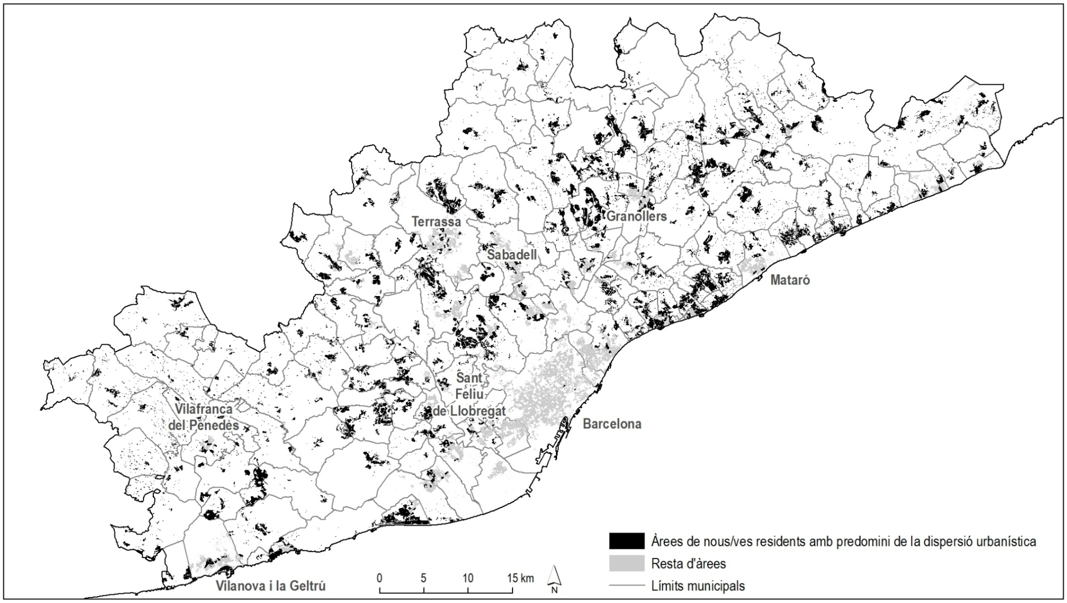
3. Neighbourhood effects in youth development
Type 1. Areas of new residents with predominance of urban dispersion
Source: Compiled from data from the Census of Population and Housing, 2001

Slide 9
3. Neighbourhood effects in youth development
Types of residential areas
b) Residential areas of skilled workers from nuclear families in medium and large municipalities
Morphology and spatial location
Municipalities over 13,000 inhabitants, none with less than 5,000 inhabitants
Areas of compact urbanization with any special building type social composition
Social composition
Nuclear families with children in emancipation age or young families with children
Middle socioeconomic status

Slide 10
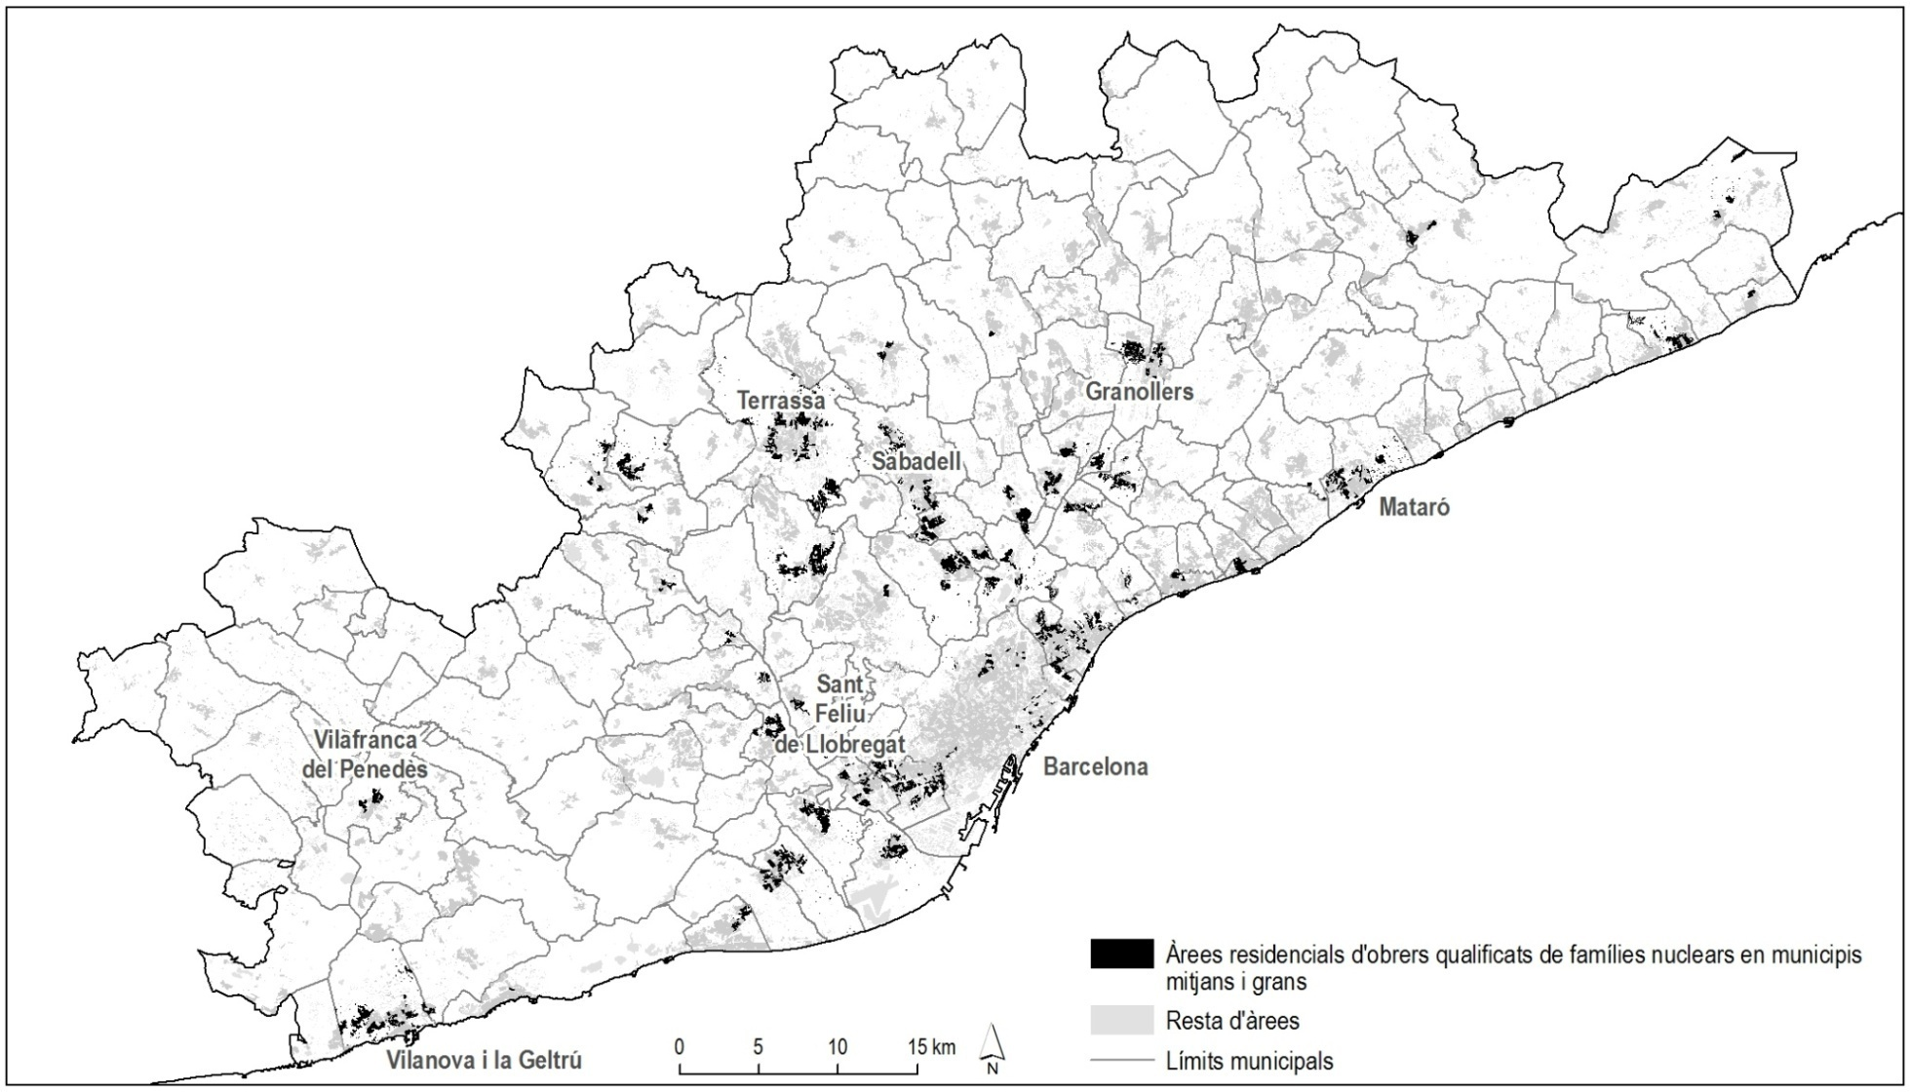
3. Neighbourhood effects in youth development
Type 2. Residential areas of skilled workers from nuclear families in medium and large municipalities medianos y grandes
Source: Compiled from data from the Census of Population and Housing, 2001

Slide 11
3. Neighbourhood effects in youth development
Types of residential areas
c) Residential areas of workers with low educational and employment level
Morphology and spatial location
Peri-urban neighbourhoods built between 40 and 70.
Ex: Bellvitge (L’Hospitalet), Serra d’en Mena (Badalona i Santa Coloma), 25 de setembre (Rubí), Buenos Aires (Martorell)
Social composition
Employed non skilled
More than half of youth non emancipated
Socioeconomic status below the mean

Slide 12
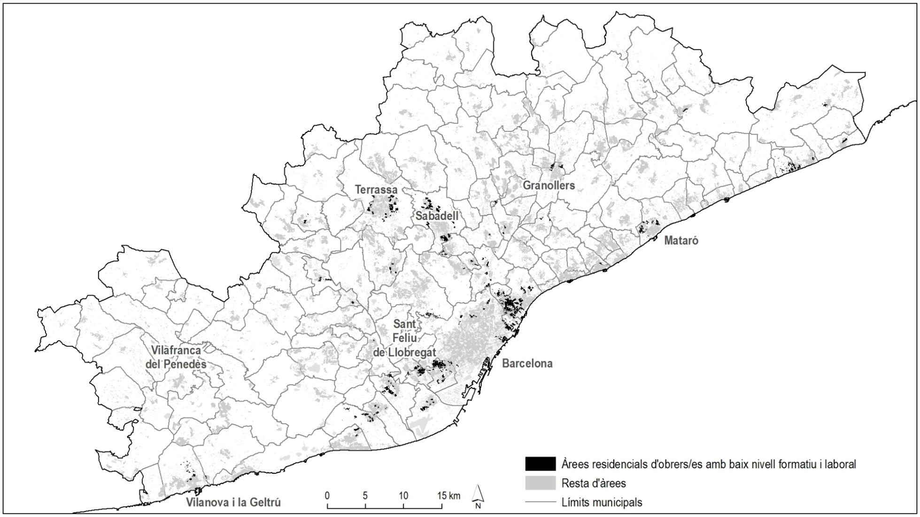
3. Neighbourhood effects in youth development
Type 3. Residential areas of workers with low educational and employment level
Source: Compiled from data from the Census of Population and Housing, 2001

Slide 13
3. Neighbourhood effects in youth development
Types of residential areas
d) Residential areas especially of old people
Morphology and spatial location
Old core downtown or adjacent areas to these of district capital and large cities
Social composition
Predominance of elderly and immigrant population
Scarce presence of simple nuclear families (two or more families households, non nuclear family, single parent household, one person household)
Socioeconomic status below the mean
Large differences between the socioeconomic status of households of emancipated youth and households with unemancipated youth

Slide 14
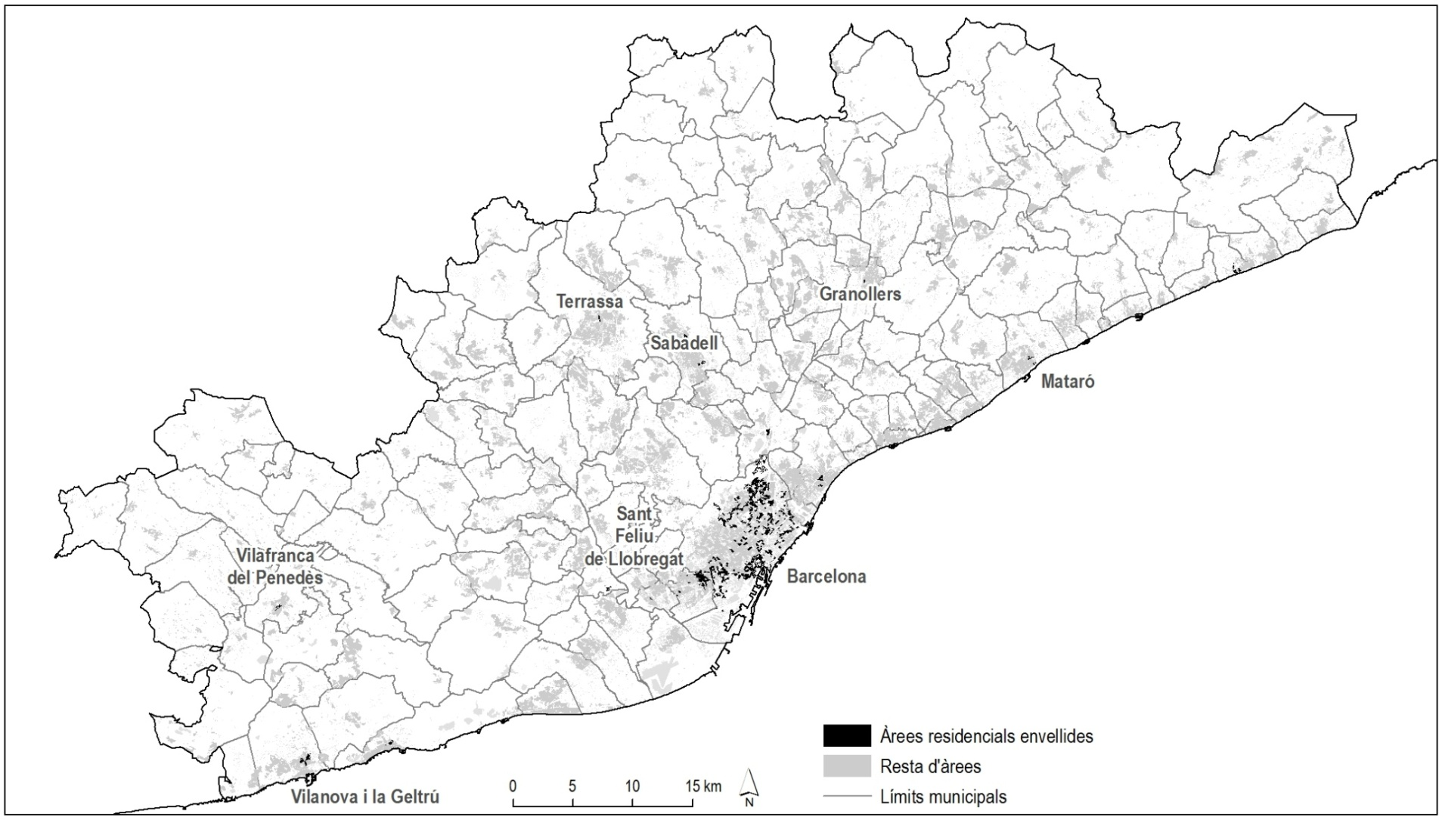
3. Neighbourhood effects in youth development
Type 4. Residential areas especially of old people
Source: Compiled from data from the Census of Population and Housing, 2001

Slide 15
3. Neighbourhood effects in youth development
Types of residential areas
e) Residential areas dominated by middle class
Morphology and spatial location
Compact downtown areas in large and medium cities
Some luxury areas
Neighbourhoods in the high socioeconomic area of ​​Barcelona
Social composition
Most of the residents are born in Catalonia
High levels of education
Socioeconomic status above the mean

Slide 16
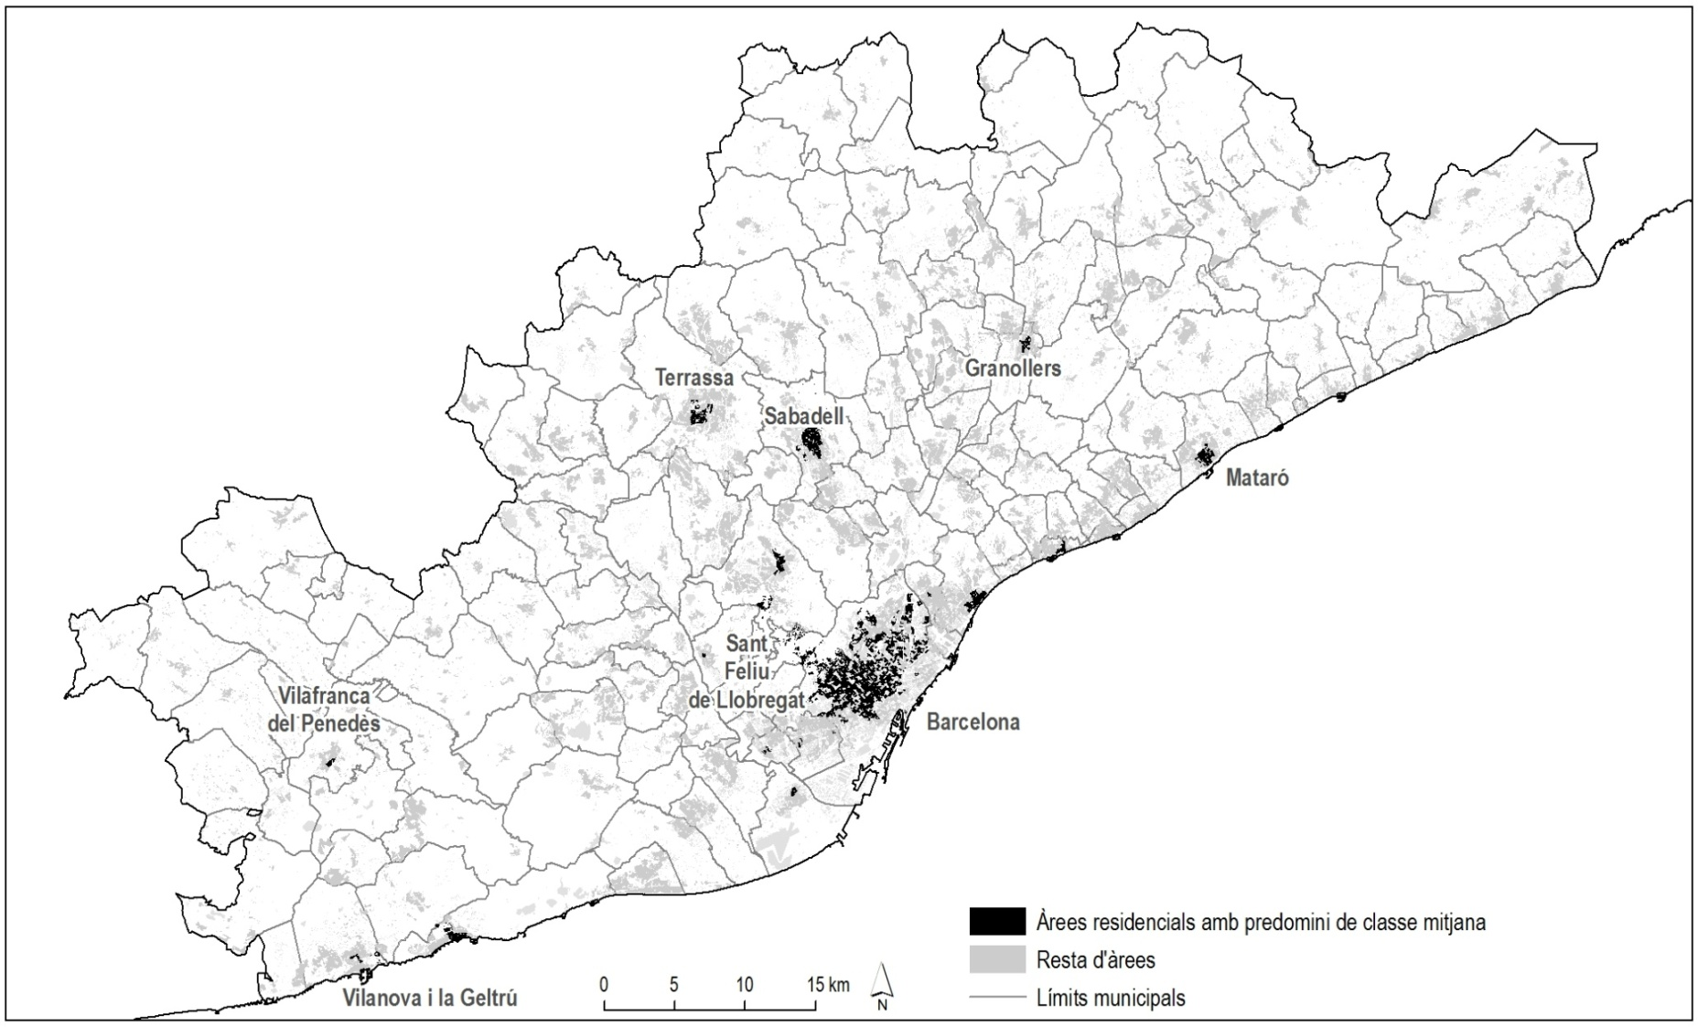
3. Neighbourhood effects in youth development
Type 5. Residential areas dominated by middle class
Source: Compiled from data from the Census of Population and Housing, 2001

Slide 17
3. Neighbourhood effects in youth development
Effects on educational level attained
Table 1. Variables comprising the multinomial logistic model (education)
 |  | Criteri d’ajust del model |  |  | Contrastos de selecció d’efectes
Model | Effecte(s) | AIC | BIC | -2 log versemblança | khi-quadrat (a,b) | ql. | Sig.
Pas 0 | Intersecció de referència | 2004,44 | 2014,38 | 2000,44 | .
Pas 1 | Maximum educational level attained by parents | 1889,61 | 1919,44 | 1877,61 | 122,82 | 4 | 0,000
Pas 2 | Màximum occupational category attained by parents | 1858,94 | 1908,65 | 1838,94 | 38,67 | 4 | 0,000
Pas 3 | Sex | 1829,76 | 1889,40 | 1805,76 | 33,19 | 2 | 0,000
Pas 4 | Mother tongue | 1819,46 | 1898,99 | 1787,46 | 18,29 | 4 | 0,001
Pas 5 | Place where live the people with whom he/she most frequently relates | 1813,74 | 1923,09 | 1769,74 | 17,72 | 6 | 0,007
Pas 6 | Type of residential area | 1807,38 | 1956,49 | 1747,38 | 22,36 | 8 | 0,004
Source. Idescat and IERMB. Survey on Living conditions and habits of the Catalan population, 2006.

Slide 18
3. Neighbourhood effects in youth development
Effects on educational level attained
Results of multinomial logistic general model (education)
Great importance of family environment.
Men are more likely than women to leave the education system just with the level of compulsory education.
The probabilities of Catalan speakers or Spanish speakers to reach a low level of education rather than a higher level is much lower than in the case of young people with other mother tongues.
The proximity of the frequent relationship is related with low educational levels.
Not to live in areas dominated by middle classes does decrease the chances to attain university studies.

Slide 19
3. Neighbourhood effects in youth development
Effects on educational level attained
Table 2. Variables that form the multinomial logistic models to different types of residential areas (1)
Type of residential area | Model | Effecte(s) | Criteri d’ajust del model |  |  | Contrastos de selecció d’efectes
 |  |  | AIC | BIC | -2 log versemb. | khi-quadrat (a,b) | ql | Sig.
Areas of new residents with predominance of urban dispersion | Pas 0 | Intersecció de referència | 428,605 | 435,299 | 424,605 | .
 | Pas 1 | Maximum educational level attained by parents | 407,986 | 428,068 | 395,986 | 28,619 | 4 | 0,000
 | Pas 2 | Mother tongue | 401,419 | 434,889 | 381,419 | 14,567 | 4 | 0,006
 | Pas 3 | Age | 396,374 | 443,233 | 368,374 | 13,044 | 4 | 0,011
 | Pas 4 | Sex | 390,734 | 444,287 | 358,734 | 9,640 | 2 | 0,008
Residential areas of skilled workers from nuclear families in medium and large municipalities | Pas 0 | Intersecció de referència | 594,477 | 602,119 | 590,477 | .
 | Pas 1 | Maximum educational level attained by parents | 586,961 | 609,888 | 574,961 | 15,516 | 4 | 0,004
 | Pas 2 | Sex | 579,523 | 610,092 | 563,523 | 11,438 | 2 | 0,003
 | Pas 3 | Age | 572,561 | 618,415 | 548,561 | 14,962 | 4 | 0,005
 | Pas 4 | Màximum occupational category attained by parents | 564,569 | 625,708 | 532,569 | 15,991 | 4 | 0,003
Residential areas of workers with low educational and employment level | Pas 0 | Intersecció de referència | 321,641 | 328,001 | 317,641 | .
 | Pas 1 | Place where live the people with whom he/she most frequently relates | 317,241 | 342,678 | 301,241 | 16,401 | 6 | 0,012
 | Pas 2 | Mother tongue | 313,470 | 351,627 | 289,470 | 11,770 | 4 | 0,019
 | Pas 3 | Age | 311,608 | 362,484 | 279,608 | 9,862 | 4 | 0,043
Residential areas especially of old people | Pas 0 | Intersecció de referència | 189,519 | 194,734 | 185,519 | .
 | Pas 1 | Màximum occupational category attained by parents | 178,822 | 194,467 | 166,822 | 18,697 | 4 | 0,001
 | Pas 2 | Age | 169,875 | 195,952 | 149,875 | 16,946 | 4 | 0,002
 | Pas 3 | Place where live the people with whom he/she most frequently relates | 164,171 | 205,893 | 132,171 | 17,704 | 6 | 0,007
Source. Idescat and IERMB. Survey on Living conditions and habits of the Catalan population, 2006.

Slide 20
3. Neighbourhood effects in youth development
Effects on educational level attained
Table 2. Variables that form the multinomial logistic models to different types of residential areas (2)
Tipus d’àrea residencial | Model | Efecte(s) | Criteri d’ajust del model |  |  | Contrastos de selecció d’efectes
 |  |  | AIC | BIC | -2 log versemb. | khi-quadrat (a,b) | ql | Sig.
Residential areas dominated by middle class | Pas 0 | Intersecció de referència | 407,696 | 414,651 | 403,696 | .
 | Pas 1 | Màximum occupational category attained by parents | 371,370 | 392,237 | 359,370 | 44,326 | 4 | 0,000
 | Pas 2 | Sex | 357,425 | 385,247 | 341,425 | 17,945 | 2 | 0,000
 | Pas 3 | Maximum educational level attained by parents | 351,321 | 393,054 | 327,321 | 14,104 | 4 | 0,007
 | Pas 4 | Place where live the people with whom he/she most frequently relates | 347,971 | 410,570 | 311,971 | 15,350 | 6 | 0,018
Source. Idescat and IERMB. Survey on Living conditions and habits of the Catalan population, 2006.

Slide 21
3. Neighbourhood effects in youth development
Effects on educational level attained
Comparative results of the estimated multinomial logistic models for each type of residential area (education)
Family environment maintains its explanatory weight in all residential areas, but looses its weight in residential areas of workers with low educational and employment level.
In the Areas of new residents with predominance of urban dispersion, age and language show differentiated behaviours in relationship to other residential areas (low educational level among the Spanish speakers between 18 and 24 years old).
In residential areas of workers with low educational and employment level and in Residential Areas especially of old people the proximity of the relationship net is associated with a low educational level. In residential areas dominated by middle class the effects are more diverse.

Slide 22
3. Neighbourhood effects in youth development
Effects on employment quality
Table 3. Variables that conform the multinomial logistic model (employment)
 |  | Criteri d’ajust del model |  |  | Contrastos de selecció d’efectes
Model | Efecte(s) | AIC | BIC | -2 log versemblança | khi-quadrat (a,b) | ql. | Sig.
Pas 0 | Intersecció de referència | 1404,54 | 1413,77 | 1400,54 | .
Pas 1 | Age | 1377,27 | 1404,93 | 1365,27 | 35,28 | 4 | 0,000
Pas 2 | Maximum educational level attained | 1352,90 | 1399,01 | 1332,90 | 32,37 | 4 | 0,000
Pas 3 | Mother tongue | 1350,68 | 1415,23 | 1322,68 | 10,22 | 4 | 0,037
Source. Idescat and IERMB. Survey on Living conditions and habits of the Catalan population, 2006.

Slide 23
4. Conclusions
Conclusions
In the RMB, residential environment produces greater impacts on the educational level attained by young people than about the quality of their occupations (imperceptible effect).
Residential environment doesn’t effect homogeneously to youth transitions that take place in the RMB (Lupton, 2003). In Residential areas of workers with low educational and employment level the explanatory weight of territory is more important than in other residential areas.
Areas of new residents with predominance of urban dispersion have a negative effect in terms of education in the case of "new generation" of young people from low socio-cultural class (hypothesis).
The proximity of the relationship net has a variable incidence in the educational level attained by type of residential environment.

Slide 24
4. Conclusions
Methodological limitations of this study
Mismatches between territorial units of analysis and spatial areas that generate the "neighborhood effects".
Difficulties to eliminate completely the spuriousness in the explanatory variables.
It is uncontrollable the remaining time of individuals in residential settings (it is needed a longitudinal analysis).
Qualitative aspects are revealed (need mixed methodology approaches).

